Slide 1
Chapter 5
Transport Layer

Slide 2
Transport Layer overview
• Convert data from upper layer (Application) to segments
• Transport layer is responsible for process-to process delivery and
congestion control
• Distinguish a particular process in a system using port number
• 3 type of delivery mechanisms available TCP, UDP,SCTP
• Connection oriented (TCP) and connection less(UDP)
• Reliable (TCP) and unreliable (UDP) services
• Port address provide process to process delivery

Slide 3
1. Process to Process Delivery
• The transport layer is responsible for process-to-process delivery
• Types of data delivering
1. Node to node delivery (data link Layer)
2. Host to host delivery (Network Layer)
3. Process to process delivery (Transport Layer)
• Process to process delivery is needed because many process will be
running in one host simultaneously
• To identify, from which process is sending the request source port address
is assigned
• To identify, to which process request is send is destination address is
assigned

Slide 4
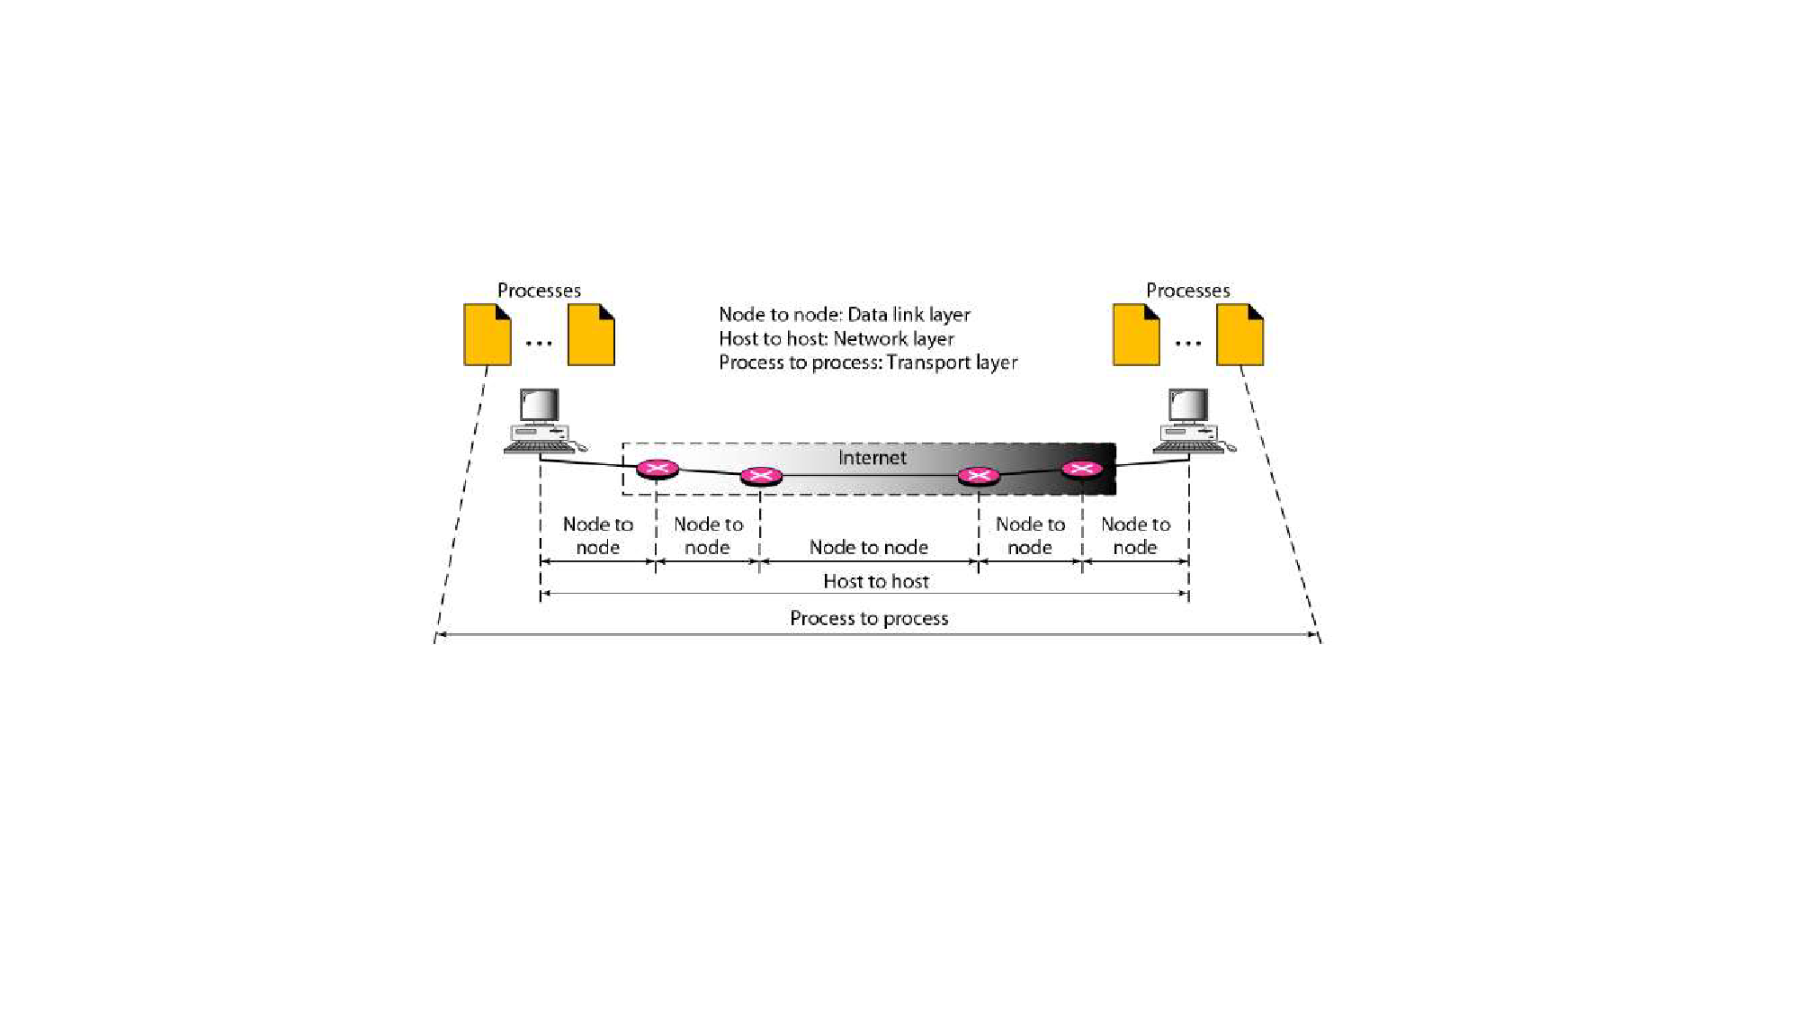
1. Process to Process Delivery
Figure: Process to Process Delivery
• Two processes communicate in a client/server relationship

Slide 5
2. 3-Way Handshaking
• TCP is connection oriented which means before data transfer
connection should be established
• Step in TCP communication
1. Connection establishment
2. Data Transfer
3. Connection termination
• Connection is established with help of 3 way handshaking protocol
• Connection termination is also done with 3 way handshaking protocol

Slide 6
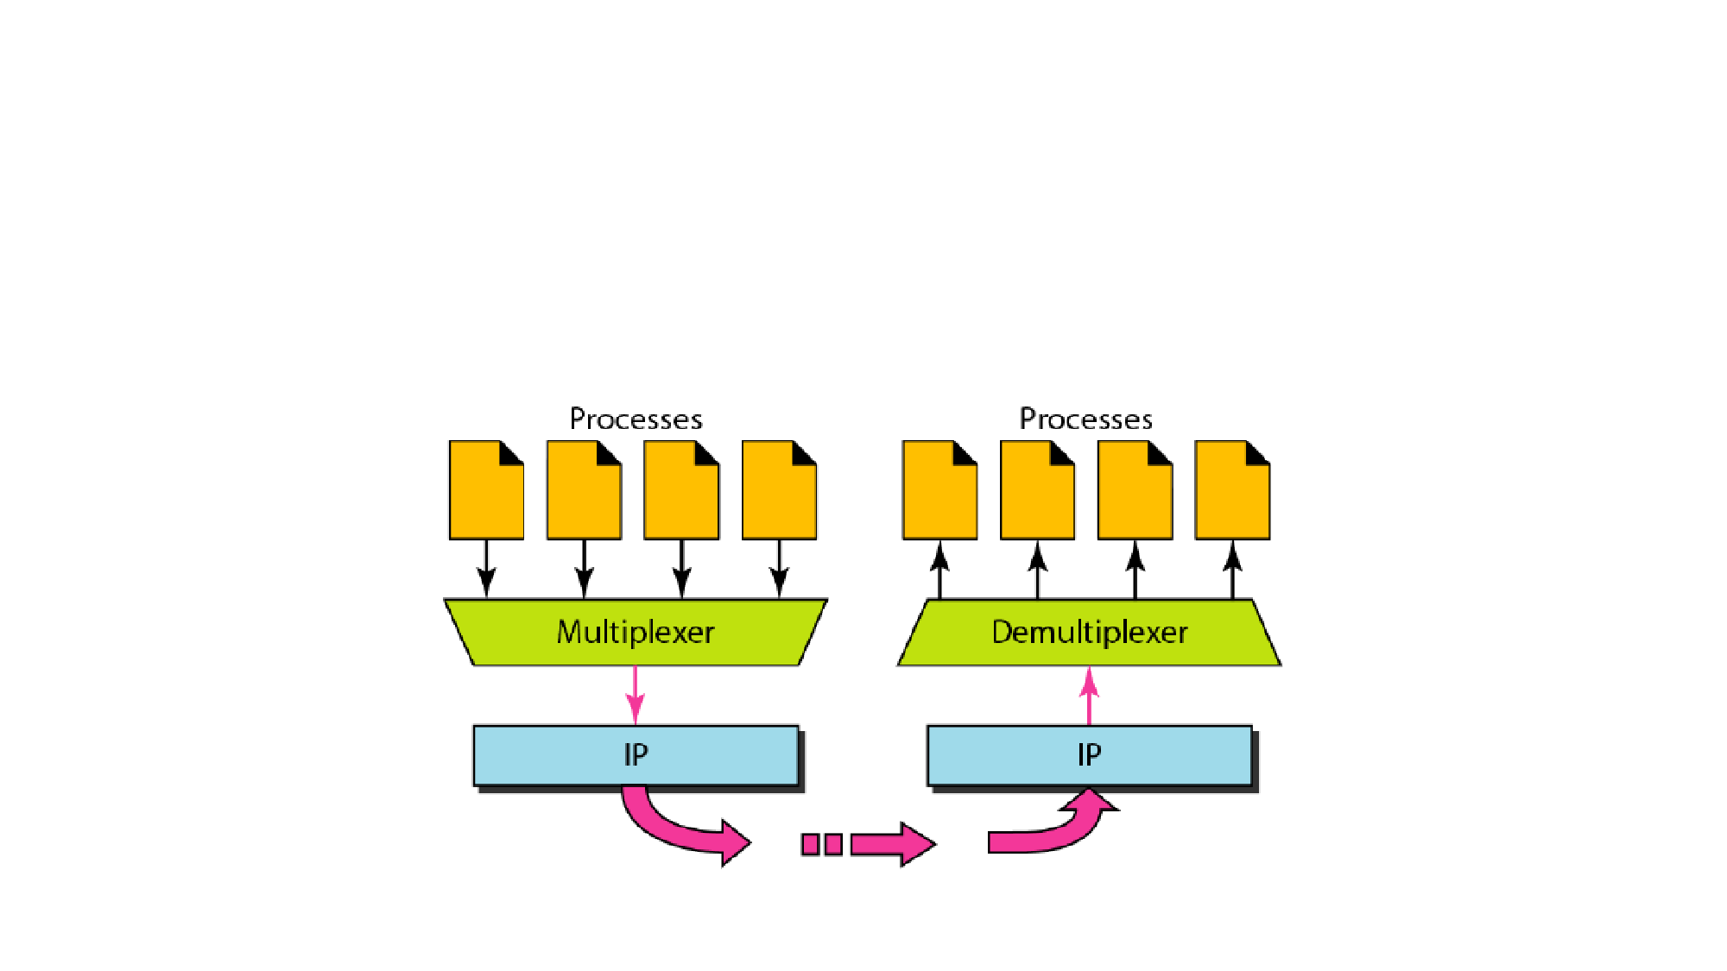
3. Multiplexing & De-multiplexing
• The addressing mechanism allows multiplexing and De-multiplexing
by the transport layer

Slide 7
3.1. Multiplexing
• At the sender site, there may be several processes that need to send
packets. However, there is only one transport layer protocol at any
time. This is a many-to-one relationship and requires multiplexing.
• The protocol accepts messages from different processes,
differentiated by their assigned port numbers. After adding the
header, the transport layer passes the packet to the network layer

Slide 8
3.2. De-multiplexing
• At the receiver site, the relationship is one-to-many and requires De-
multiplexing. The transport layer receives datagrams from the
network layer.
• After error checking and dropping of the header, the transport layer
delivers each message to the appropriate process based on the port
number

Slide 9
4. Port Numbers
• Port Address (Number) is needed to choose among multiple
processes running on the destination host
• The destination port number is needed for delivery and the source
port number is needed for the reply
• Port number is 16 bit integer
• Range between 0-65535
• Source port number is chosen randomly(Dynamic range)
• Destination port is chose based on application(For ex, HTTP-80, FTP-
20,21)

Slide 10
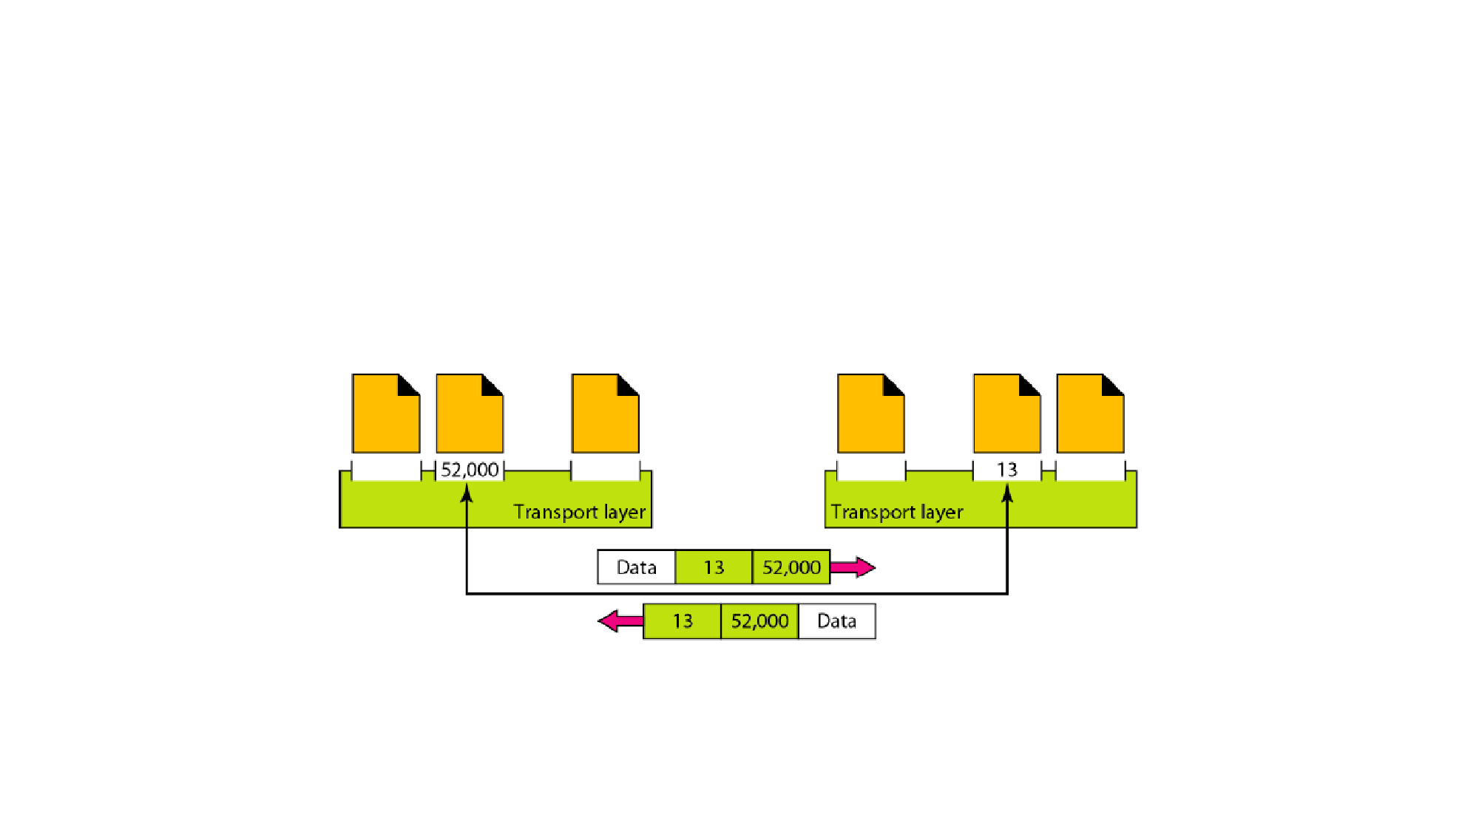
4. Port Numbers
• Data is sent from system one have process with port number 52000
and other system have a process with port number 13

Slide 11
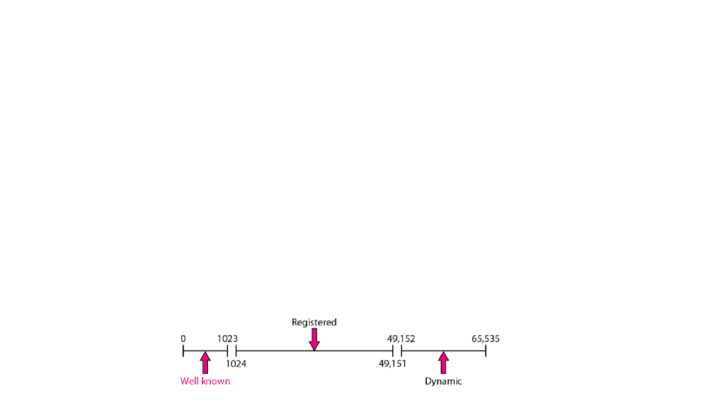
4.1. Port numbers- IANA ranges
• The lANA (Internet Assigned Number Authority) has divided the port
numbers into three ranges:
• Well known ports (Range between 0-1023): Controlled by IANA
• Registered ports (Range between 1024-49151): not controlled by
IANA but can be register to prevent duplication
• Dynamic(Private) ports (Range between 49152-65535): The ports
ranging from 49,152 to 65,535 are neither controlled nor registered.
They can be used by any process

Slide 12
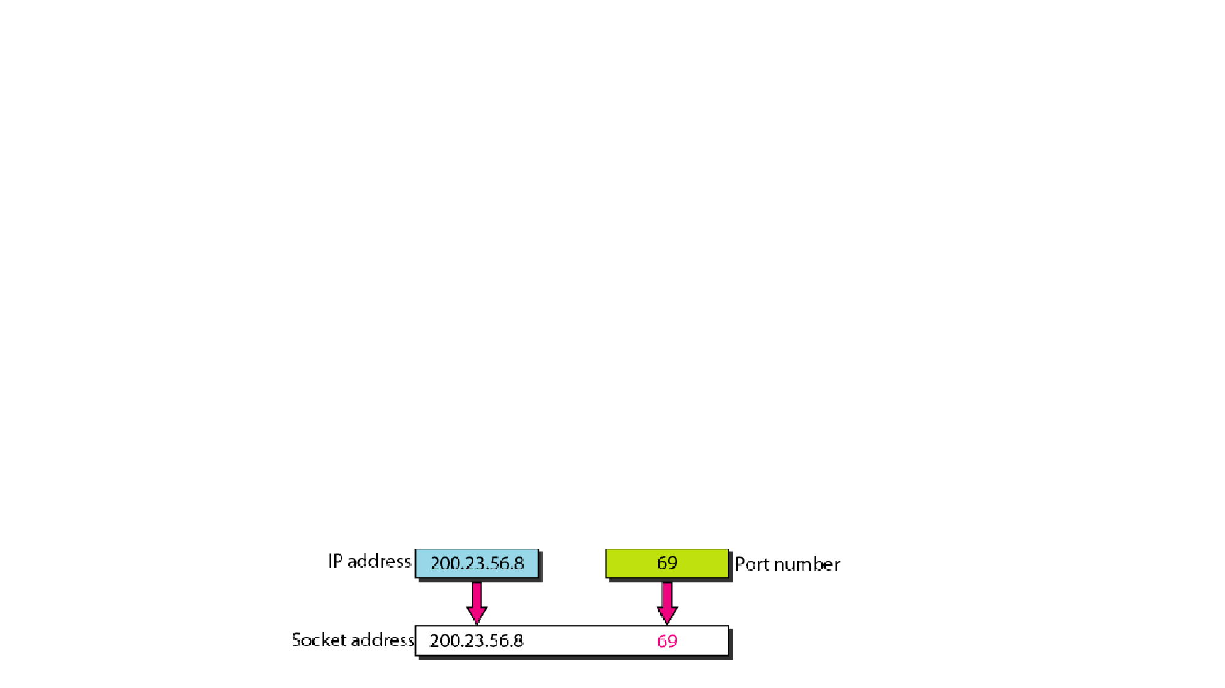
4.2. Socket Address
• Process-to-process delivery needs two identifiers, IP address and the
port number, at each end to make a connection
• Combination of an IP address and a port number is called a socket
address
• The client socket address defines the client process uniquely just as
the server socket address defines the server process uniquely
• A transport layer protocol (TCP/UDP)needs a pair of socket addresses:
the source socket address and the destination socket address

Slide 13
5 Connection Less(UDP)
• Packets are sent from one party to another with no need for
connection establishment or connection release
• The packets are not numbered
• They may be delayed or lost or may arrive out of sequence
• There is no acknowledgment
• UDP is connectionless

Slide 14
5 Connection Oriented(TCP)
• Connection is first established between the sender and the receiver
• Data are transferred
• Connection is released
• TCP and SCTP are connection-oriented protocols

Slide 15
5. User Datagram Protocol(UDP)
• Connection less & Unreliable Service
• No flow and error control mechanisms at the transport level
• UDP uses port numbers for communication
Well Known UDP Ports
•
•
•
•
•
Daytime-13
DNS-53
TFTP-69
RPC-111
NTP-123

Slide 16
5.1. Features of UDP
• Connectionless:
• No connection is established before data transfer
• user datagram(segment) sent by UDP is an independent datagram
• Flow and Error Control:
• No error flow control (Only optional error checking)
• No retransmission
• No acknowledgments

Slide 17
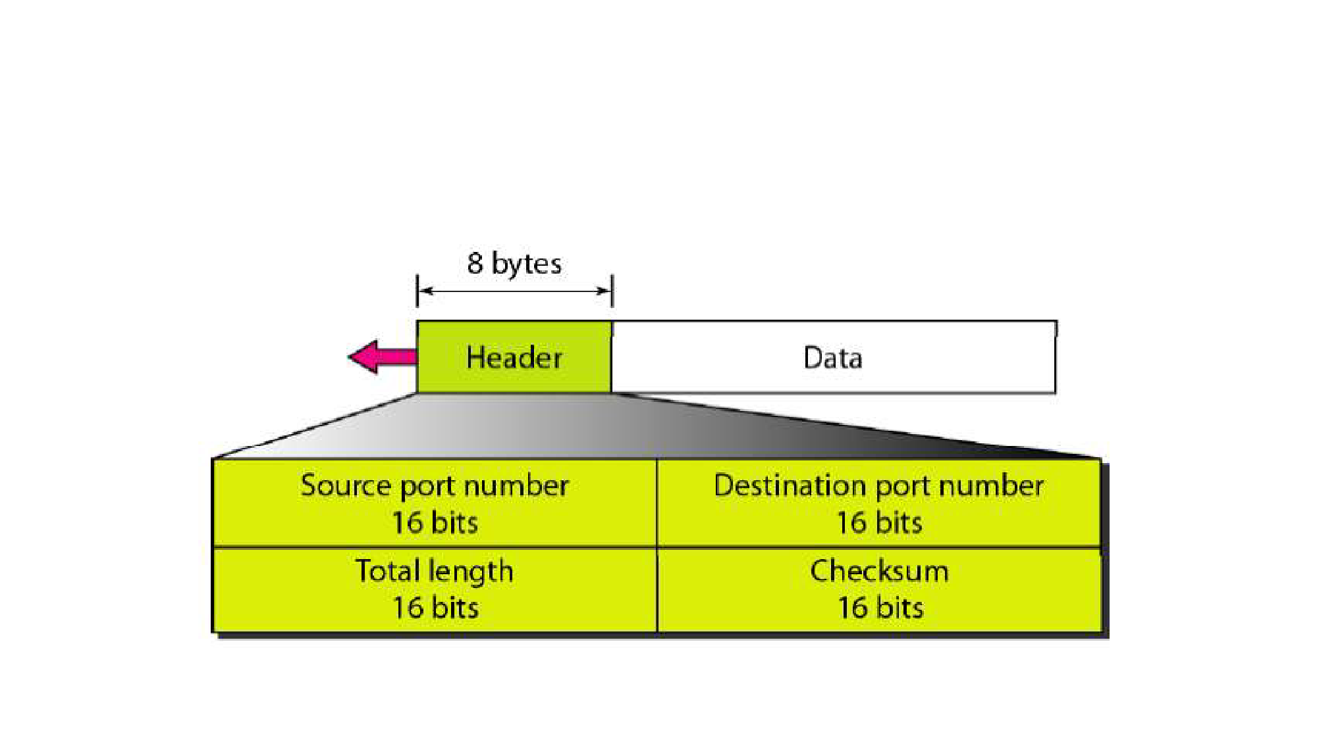
5.2. UDP Segment

Slide 18
5.2. UDP Segment
• Source port number(16 bits)
• This is the port number used by the process running on the source host
• Range 0-65535
• Destination port number(16 bits)
• This is the port number used by the process running on the destination host
• Range 0-65535
• Length
• Defines the total length of the user datagram, header plus data.
• Length ranges between 8 to 65,535 bytes
• Checksum
• For error checking

Slide 19
3 Reliable vs Unreliable
Reliable
Unreliable
• Have error control
• Have Flow control
• Connection oriented
• Have ACK and sequence number
• TCP &SCTP
• No error control
• No Flow control
• Connectionless
• No ACK and sequence number
• UDP

Slide 20
4. Transmission Control Protocol(TCP)
• Connection oriented & Reliable Service
• TCP uses flow and error control mechanisms at the transport level
• TCP uses port numbers for communication
Well Known TCP Ports
•
•
•
•
•
•
FTP- 20(data), 21(control)
TELNET- 23
SMTP-25
DNS-53
HTTP-80
RPC-111

Slide 21
4.1. TCP Features
• Stream delivery (No boundary defined)
• Full duplex communication
• Numbering systems
• TCP software keeps track of the segments being transmitted or received,
there is no field for a segment number value in the segment header
• The bytes of data being transferred in each connection are numbered by TCP.
The numbering starts with a randomly generated number
• Sequence Number:
• The sequence number for each segment is the number of the first byte
(randomly assigned) carried in that segment

Slide 22
4.1. TCP Features
• Acknowledgment number:
• Full duplex sequence number and Acknowledgment in same segment
• If receiver receives x bytes Ack number is equal to x+1
• Flow control& Error control:
• TCP uses byte oriented flow & error control
• Congestion control
• Also control the congestion in the network

Slide 23
4.1.1 TCP Sequence numbering
• Suppose a TCP connection is transferring a file of 5000 bytes. The first
byte is numbered 1O,001. each carrying segment carry 1000 bytes
The following shows the sequence number for each segment:
• Segment 1 Sequence Number: 10,001 (range: 10,001 to 11,000)
• Segment 2 Sequence Number: 11,001 (range: 11,001 to 12,000)
• Segment 3 Sequence Number: 12,001 (range: 12,001 to 13,000)
• Segment 4 Sequence Number: 13,001 (range: 13,001 to 14,000)
• Segment 5 Sequence Number: 14,001 (range: 14,001 to 15,000)

Slide 24
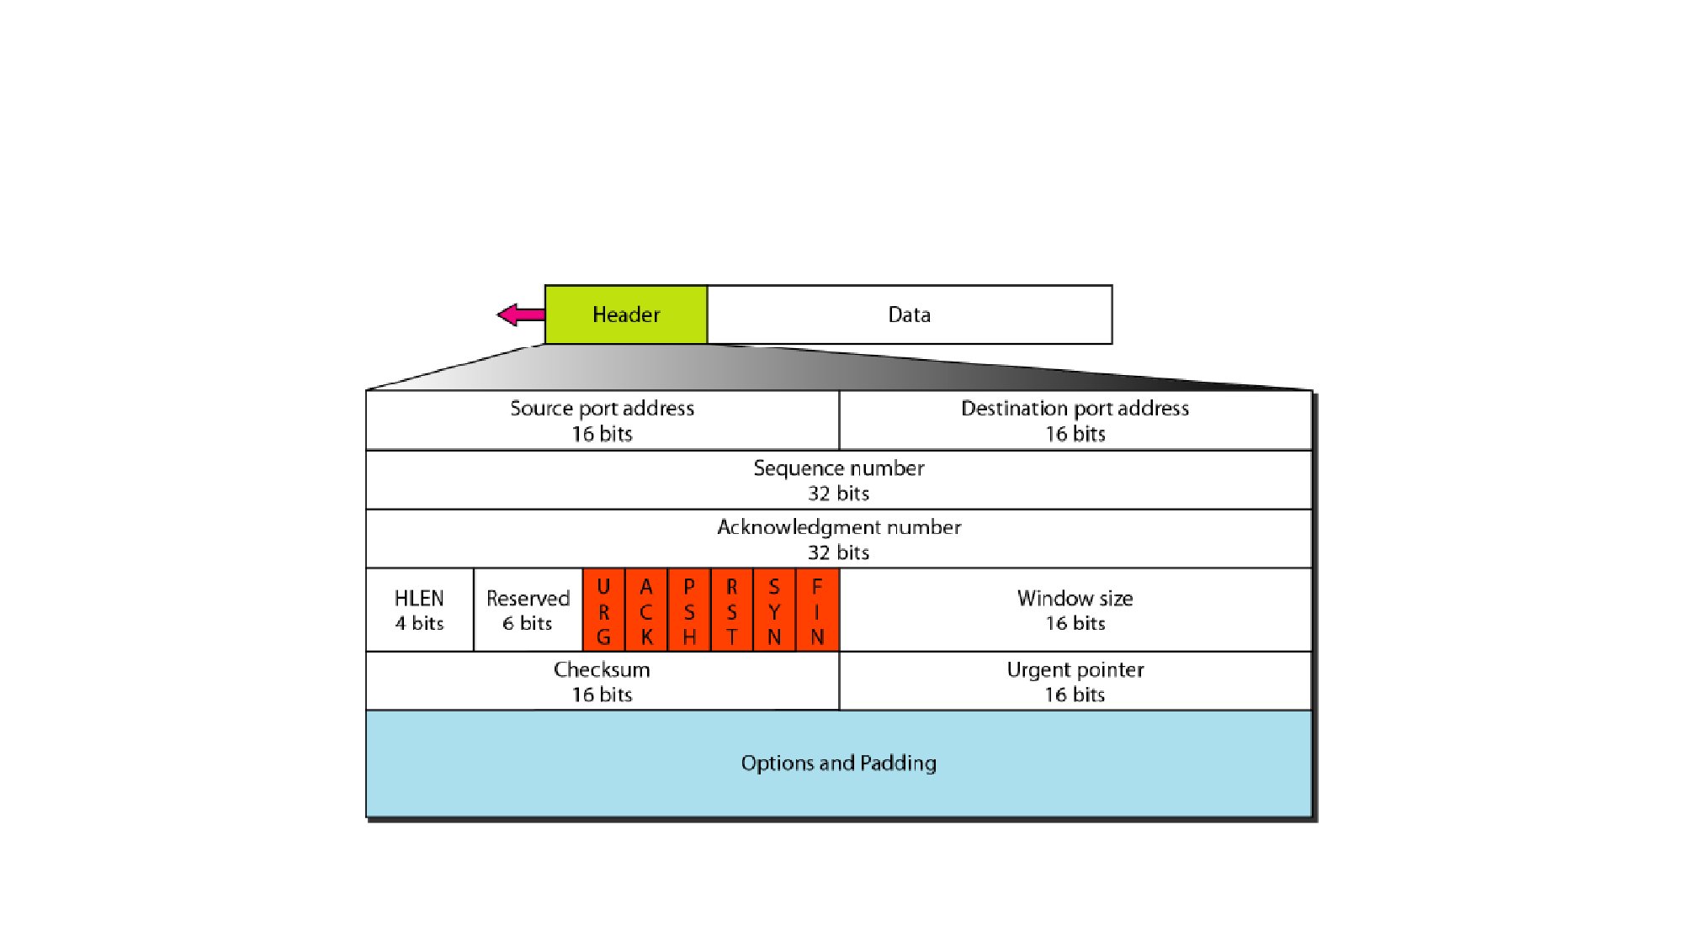
4.2. TCP Segment Format

Slide 25
4.2. TCP Segment Format
• Source port address: Port address of sender
• Destination port address: port address of receiver
• Sequence number: 32 bit integer usually represented by first bytes
number
• Acknowledge number:32 bit integer, x bytes are received Ack will be
x+1
• Header Length (HLEN) : usually between 20-60 bytes
• Reserved: future use

Slide 26
4.2. TCP Segment Format
• Flag (6 bits):
1.
2.
3.
4.
5.
6.
URG: Urgent pointer is valid
ACK: Acknowledgment is valid
PSH: Request for push
RST: Reset the connection
SYN: Synchronize sequence numbers
FIN: Terminate the connection
• Window size
• This field defines the size of the window, in bytes, that the other party must
maintain. 16 bit so maximum size of the window is 65,535 bytes. Usually
determined by reciever

Slide 27
4.2. TCP Segment Format
• Urgent pointer.
• This l6-bit field, which is valid only if the urgent flag is set, is used when the
segment contains urgent data.
• Options
• There can be up to 40 bytes of optional information in the TCP header.

Slide 28
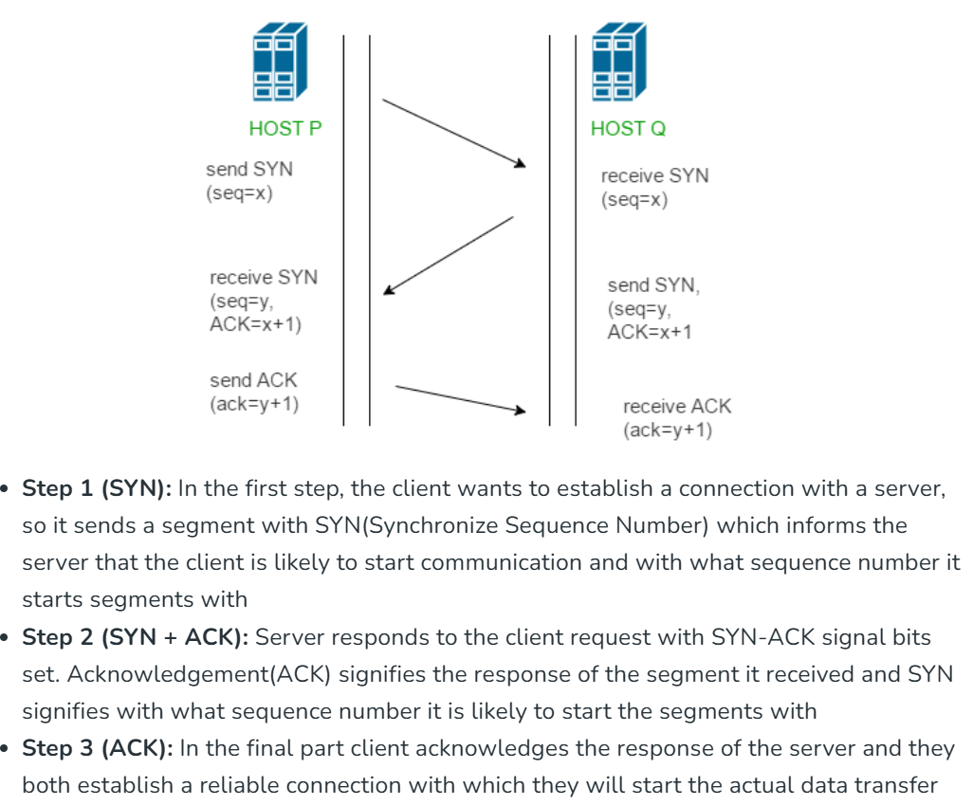
TCP 3- Way Handshaking

Slide 29
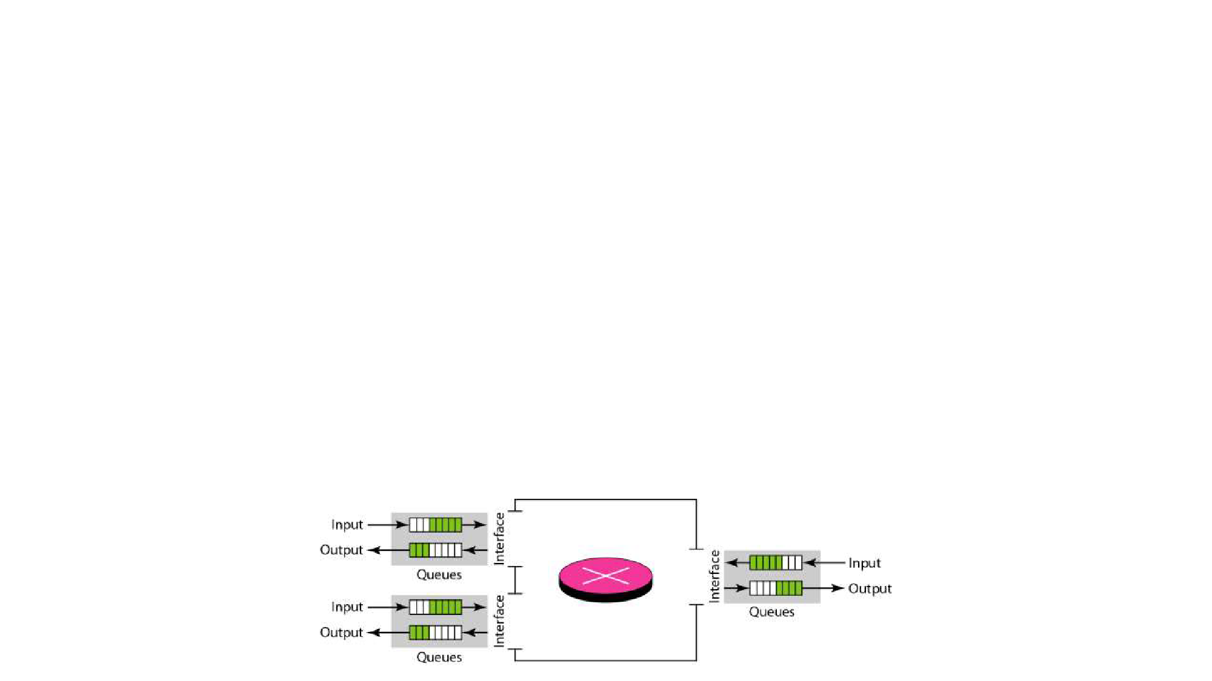
1. Congestion
• Load of network → The number of packets sent to the network
• Capacity of network → The number of packets that can be handle
• Congestion occurs when the load of network is greater than capacity
of network
• Congestion occurs because of the following factor
1. Processing capacity of router
2. No of Packets in input and output interface

Slide 30
2. Congestion Control
• Congestion control refers to techniques and mechanisms that can
either prevent congestion, before it happens, or remove congestion,
after it has happened
• Congestion control mechanisms into two broad categories:
1. Open-loop congestion control (prevention)
2. Closed-loop congestion control (removal)

Slide 31
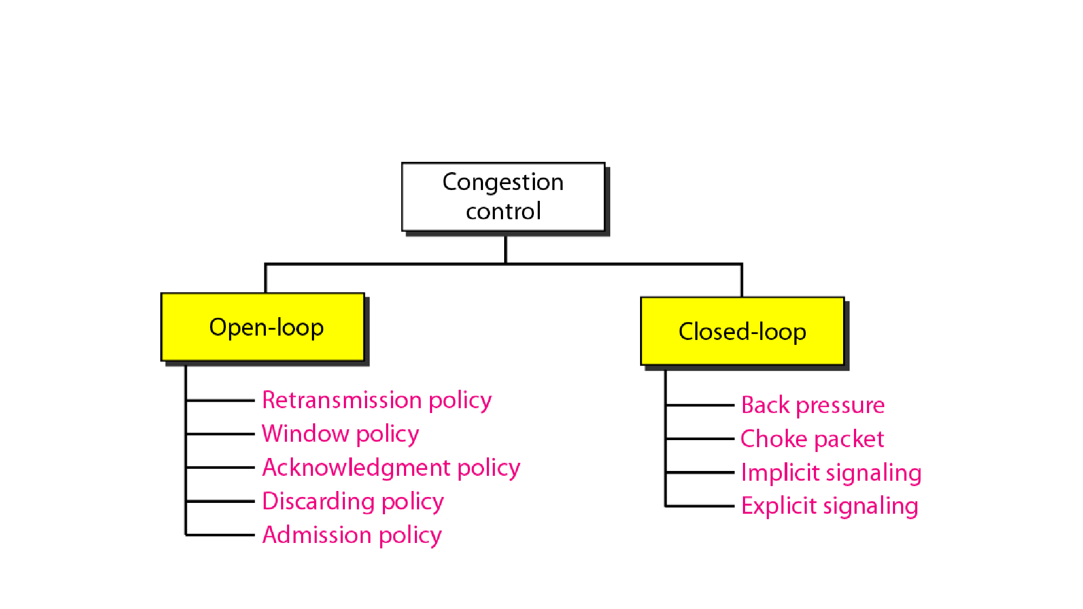
2. Congestion Control

Slide 32
2.1. Open Loop Congestion
• Congestion Prevention mechanism
• Policies are applied to prevent congestion before it happens
• Congestion control is handled by either the source or the destination
1.
2.
3.
4.
5.
Retransmission policy
Windowing policy
Acknowledge policy
Discard policy
Admission policy

Slide 33
2.1.1. Retransmission policy
• Retransmission is sometimes unavoidable
• If the sender feels that a sent packet is lost or corrupted, the packet
needs to be retransmitted
• Retransmission in general may increase congestion in the network
• Good retransmission policy can prevent congestion
• The retransmission policy and the retransmission timers must be
designed to optimize efficiency and at the same time prevent
congestion

Slide 34
2.1.2.Windowing policy
• The Selective Repeat window is better than the Go-Back-N window
for congestion control
• In the Go-Back-N window, when the timer for a packet times out,
several packets may be resent, even if some may have arrived safe
and sound at the receiver
• The Selective Repeat window, on the other hand, tries to send the
specific packets that have been lost or corrupted

Slide 35
2.1.3. Acknowledge Policy
• Acknowledgments are also part of the load in a network
• The acknowledgment policy imposed by the receiver may also affect
congestion
• If receiver acknowledges every packet there is change for congestion
in network(Stop and wait)
• If the receiver does not acknowledge every packet it receives, it may
slow down the sender and help prevent congestion. (Sliding window
like Go back-N and Selective repeat )

Slide 36
2.1.4. Discard Policy
• A good discarding policy by the routers may prevent congestion and
at the same time may not harm the integrity of the transmission
• According to priority packet is discarded
• Less sensitive packets should be discarded

Slide 37
2.1.5. Admission Policy
• Prevent congestion in virtual-circuit networks
• Before creating virtual circuit check the check the resource
requirement
• A router can deny establishing a virtual circuit connection if there is
congestion in the network or if there is a possibility of future
congestion

Slide 38
2.2. Closed-Loop Congestion Control
• Closed-loop congestion control mechanisms try to alleviate
congestion after it happens
• Several mechanisms have been used by different protocols, They are
1.
2.
3.
4.
Back pressure
Choke packet
Implicit signalling
Explicit signalling
1.
2.
Forward signalling
Backward signalling

Slide 39
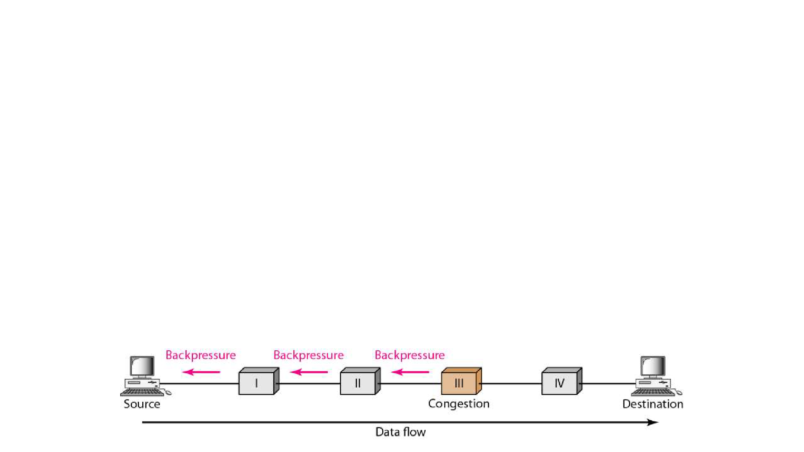
2.2.1. Back Pressure
• Backpressure refers to a congestion control mechanism in which a
congested node stops receiving data from the immediate upstream
node or nodes.
• Backpressure is a node-to-node congestion control
• Starts from congested node propagates, in the opposite direction of
data flow, to the source
• Backpressure technique can be applied only to virtual circuit

Slide 40
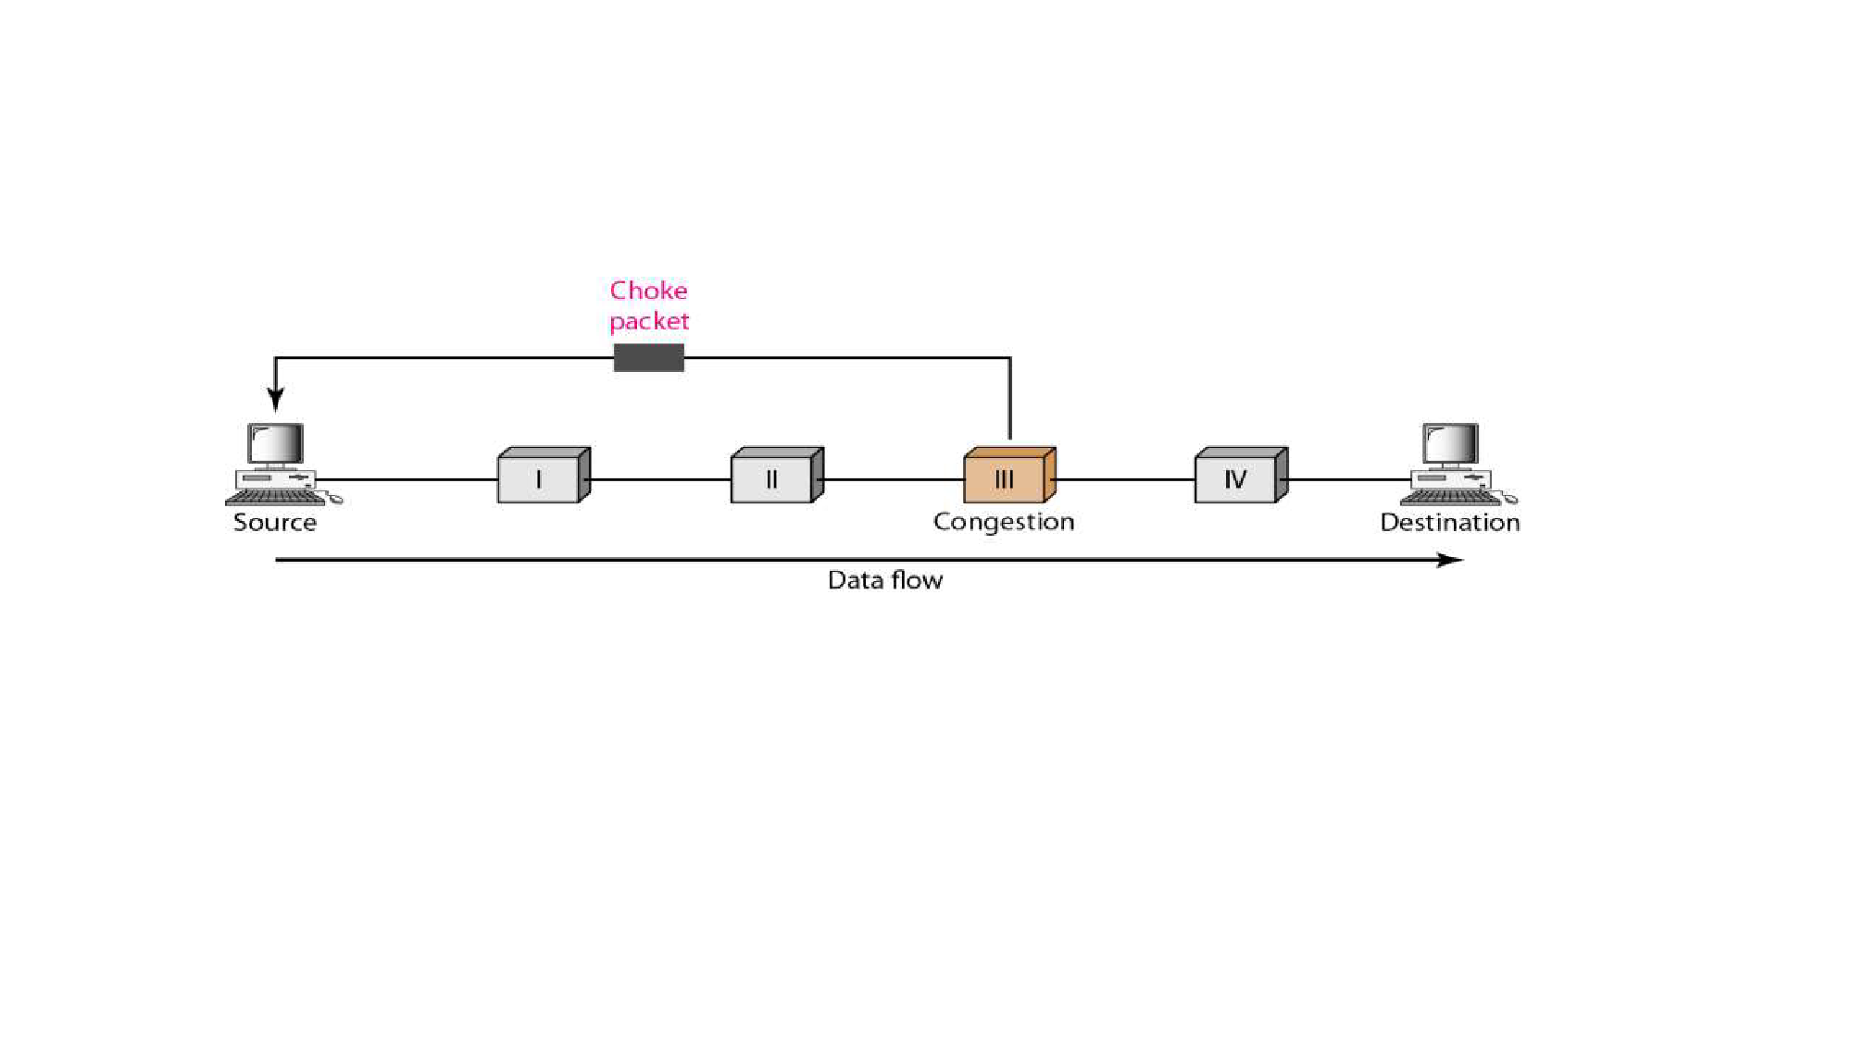
2.2.2. Choke packet
• A choke packet is a packet sent by a node to the source to inform it of
congestion
• Warning is from the congested encountered router to the source
station directly
• Intermediate nodes doesn’t know about congestion.

Slide 41
2.2.3. Implicit Signalling
• No communication between the congested nodes and the source
• Source guesses that there is a congestion somewhere in the network
from other symptoms
• Signals like acknowledgement is used
• If ACK is delayed the source assume there is congestion in
destination and slows down the data transfer
• Used mainly in TCP network

Slide 42
2.2.4. Explicit Signalling
• The node that experiences congestion can explicitly send a signal to
the source or destination
• Here only difference from choke packet is no separate packet is used
where as in the choke packet separate packet is used
• It is used in Frame relay
• 2 types of signalling
1. Forward signalling
2. Backward signalling

Slide 43
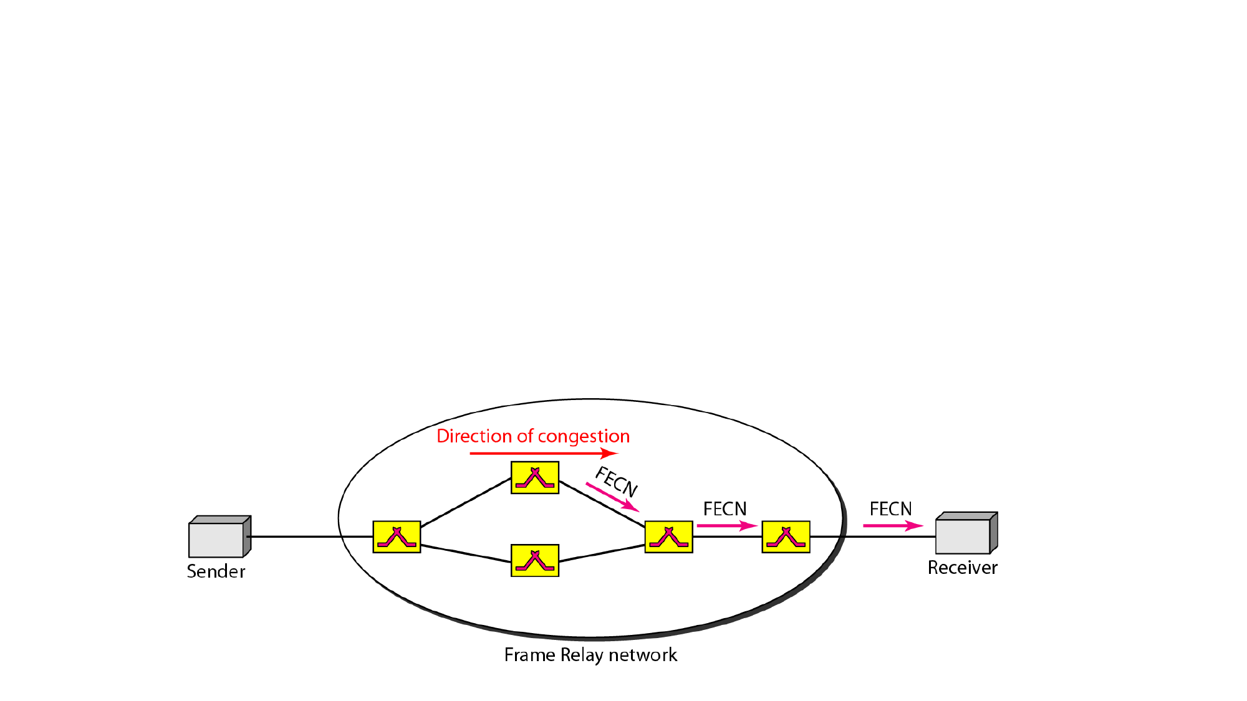
2.2.4.1. Forward Explicit Signalling
• A bit can be set in a packet moving in the direction of the congestion
• This bit can warn the destination that there is congestion
• The receiver in this case can use policies, such as slowing down the
acknowledgments, to alleviate the I congestion.
Notes:
Alleviate == less severe

Slide 44
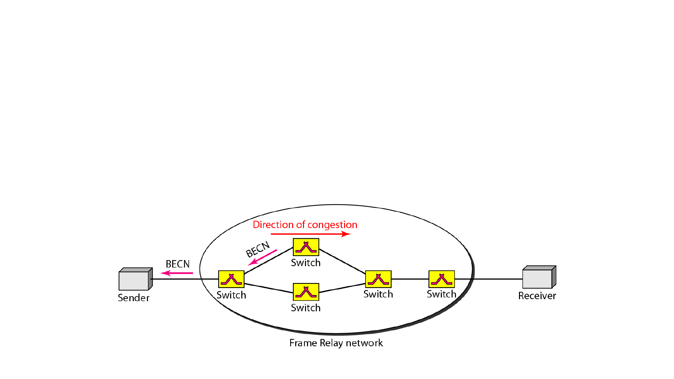
2.2.4.2. Backward Explicit Signalling
• A bit can be set in a packet moving in the direction opposite to the
congestion
• This bit can warn the source that there is congestion and that it needs
to slow down to avoid the discarding of packets

Slide 45
3. Traffic Shaping(QoS)
Traffic shaping is a mechanism to control the amount and the rate of the traffic sent to the network
Two techniques can shape traffic
  Leaky bucket
  Token bucket

Slide 46

3.1. Leaky Bucket
If a bucket has a small hole at the bottom, the water leaks from the bucket at a constant rate as long as there is water in the bucket. The rate at which the water leaks does not depend on the rate at which the water is input to the bucket unless the bucket is empty
NB: In Network Bucket is router and water is data packets

Slide 47
3.1. Leaky Bucket
NB: In the figure, we assume that the network has committed a bandwidth of 3 Mbps for a host. The use of the leaky bucket shapes the input traffic to make it conform to this commitment. The host sends a burst of data at a rate of 12 Mbps for 2 s, for a total of 24 Mbits of data. The host is silent for 5 s and then sends data at a rate of 2Mbps for 3 s, for a total of 6 Mbits of data. In all, the host has sent 30 Mbits of data in 10 s
The input rate can vary, but the output rate remains constant
Similarly, in networking, a technique called leaky bucket can smooth out bursty traffic, Bursty chunks are stored in router and sent out at an average rate
It may also drop the packet if the bucket is full

Slide 48

3.1.1. Leaky bucket Implementation

Slide 49
3.1.1. Leaky bucket Implementation
Process removes a fixed number of packets from the queue at each tick of the clock
If the traffic consists of variable-length packets, the fixed output rate must be based on the number of bytes or bits.
The following is an algorithm for variable-length packets:
  Initialize a counter to n at the tick of the clock.
  If n is greater than the size of the packet, send the packet and decrement the counter by the packet size. Repeat this step until n is smaller than the packet size.
  Reset the counter and go to step 1

Slide 50
3.1.2. Token Bucket
The host can send bursty data as long as the bucket is not empty
Token bucket algorithm allows idle hosts to accumulate credit for the future in the form of tokens
For each tick of the clock, the system sends n tokens to the bucket
The system removes one token for every cell (or byte) of data sent
For example, if n is 100 and the host is idle for 100 ticks, the bucket collects 10,000 tokens. Now the host can consume all these tokens in one tick with 10,000 cells, or the host takes 1000 ticks with 10 cells per tick

Slide 51
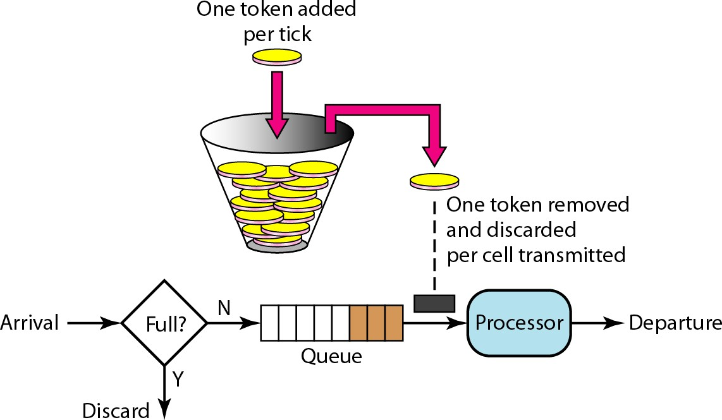
3.1.2. Token Bucket

Slide 52
3.1.2. Token Bucket
The token bucket can easily be implemented with a counter
  The token is initialized to zero
  Each time a token is added, the counter is incremented by 1
  Each time a unit of data is sent, the counter is decremented by 1
  When the counter is zero, the host cannot send data

